Slide 1
UHV-I
Session 11
Fulfilment in Relationship – Other Feelings
Shifting from competition to excellence, infatuation to love…

Slide 2
Interaction Before Main Session
Hear from participants about their exploration from previous day(s)
Q&A
Place some expected conclusions, find out if they also came to these/similar conclusions

Slide 3
Home Assignments
10.1. Write down what would be the right evaluation of yourself. Mention any five points. Recall when you were over-, under-, otherwise evaluated in the past. How did you feel in each case? Share an example of each case.
10.2. How do you feel when the other differentiates in relationship with you? How do you feel when you differentiate, or try to show you are special, different? Share one or two incidents of these situations
10.3. What have you been able to explore regarding complementarity in your close relationships? Give one or two examples of how you can be complementary to a person from a different age, region, sect, belief, etc.
Notes:
To be done
Recall an example of when you were over-under-otherwise evaluated. How did you feel in each case
Are you differentiating or accepting the other as similar to you?
Give examples of how you can be complementary to a person from a different region, sect, belief, etc.

Slide 4
UHV-I
Session 11
Fulfilment in Relationship – Other Feelings
Shifting from competition to excellence, infatuation to love…

Slide 5
Trust and Respect
So far, we discussed the feelings of Trust and Respect.
Trust is the assurance that the natural acceptance of the other is to make me happy and prosperous
To make a successful program with the other, it is essential to rightly evaluate oneself and the other
We have seen that right evaluation is respect
Can you see that Trust (assurance) and Respect (right evaluation) are at the base of any relationship?

Slide 6

Affection
The feeling of being related to the other
(acceptance of the other as one’s relative, the other is like me)
nwljs dks laca/kh ds :i esa Lohdkjus dk HkkoA fufoZj®f/krkA
One has the responsibility and commitment for mutual fulfilment in the relationship
Opposition, jealousy... are an indication of the absence of affection

Slide 7
Meaningful Interaction (with affection)
Ragging (lack of affection)
When we are not able to see the relationship with the newcomers, then we may tease them, make fun of them just for the sake of fun
We are not concerned about its impact on the newcomer. Of course, it hurts others. That is ragging
Can you recall, how does it feel, when you are hurt by someone? For how many days/ months/ years, it disturbed you?
Is it wise/ a normal mental status to seek enjoyment by hurting others?
How do you feel when a relative/ friend comes to your family?
We feel happy about it. We want to share many things with them and also listen from them. This exchange of feelings and words satisfies all of us.
That is interaction
(Here, we feel connected with them, take care of their immediate needs, and facilitate them to set their things in order….)

Slide 8
Meaningful Interaction vs. Ragging
Of course, a welcoming healthy interaction is a must, because we are a member of the same institute family, will be staying together for 3-4 years
Thus, we are related to each other, we want to know each other so that we can be of help for each other in the process of understanding and learning together
With the feeling of affection, we can work for excellence in each other
Think of ways to develop interaction with affection, rather than ragging

Slide 9
Natural Acceptance for Excellence
We, all of us want to excel in life
Let us understand excellence – We will explore if it is about
a. being better than another in a particular area of life
or
b. something else
So, let us explore!
We will also explore the program for excellence – is it
a. through competition?
or
b. through collaboration?
Notes:
We are placing what we will explore. We DO NOT NEED to ask the students for their opinions before placing the proposal about excellence
DO NOT DWELL ON THIS SLIDE

Slide 10
Reverence and Excellence ¼Js’Brk½
Excellence
Understanding Harmony
and
Living in Harmony
Continuous Happiness
Making effort for Excellence and Competing with the other is not the same thing.
In excellence, one helps to bring the other to her/his level
In competition, one avoids the other to come to her/his level
Reverence is the feeling of acceptance for excellence (in the other)
Js’Brk dh LohÑfr dk HkkoA
Self Reflection:
  How many students in a class can understand?
  How many students can come first in a class?
at all levels of being
  As an individual human being
  As a member of the family
  As a member of society
  As a unit in nature/existence
  All can understand, achieve excellence
  Only 1 can come first, be “special”

Slide 11
Competing to be Special
Complementing for Excellence
I am special, I have to be above others
We are opposed to each other
Competition is relative (no completion point)
I have a feeling of opposition
I prevent the other to come to my level, I make effort to increase the difference (may even dominate, manipulate, exploit)
I operate on the basis of pre-conditionings
I over-evaluate or under-evaluate myself and the other
I am dictated by the other, the other is my reference
The other is like me
We are complementary to each other
Excellence is absolute (definite completion point)
I have a feeling of relationship
I help the other to come to my level, I make effort to learn from the other (with feeling of relationship)
I operate on the basis of my Natural Acceptance
I do right evaluation of myself and the other
I am self-referential, self-confident
Can you see the difference? Which way do you choose to go?
Notes:
self-referential = able to refer to my NA, able to decide what is right on my own, every time → I am self-confident

Slide 12
Classroom A – Competition Oriented
Classroom B – Excellence Oriented
Both classes have a topper scoring 90%.
Topper doesn’t share learning with classmates
Learns remaining 10% from outside sources and does not share the sources with others
Environment of comparison, fear (of failure, of each other…) – pulling each other down
Topper shares learning freely with classmates
Learns remaining 10% from classmates and outside sources, shares sources with others
Environment of collective achievement, sharing and caring for each other – uplifting each other
In which class will more students be developed?
In which class will students feel it easy to study?
In which class will the teacher feel comfortable?
I
In which class would parents like to send their children?
Which class students will think for the society, for nature?
Which class will produce better human beings?
What kind of class do want this class to be A or B?

Slide 13
Self Reflection
You want to be excellent or to be special, different from the other?
The other wants to be excellent or the other wants to be special?
You want to jointly make effort for excellence or to compete to be special ?
Which feelings are essential for teamwork to take place?
Which feelings are essential for taking help in understanding from others?

Slide 14
Competition and Collaboration/Cooperation
Adverse impact of feeling of Competition:
  On our own sense of fulfillment
  On other human beings with whom we are interacting
  On the society and nature
  We feel unhappy, whenever we have a feeling of competition within
  Hinders the growth of others and makes them unhappy
  Promotes struggle, war etc in the society
  Over-consumption and therefore exploitation of natural resources
  Has piece-meal approach
Collaboration/Cooperation
  When we feel related to each other, we cooperate
  Our natural acceptance is for relationship and cooperation

Slide 15
Gratitude ¼d`rKrk½
Feeling for those who have worked for my excellence
ftUgksaus esjh Js’Brk ds fy, iz;kl fd;k gS] muds izfr HkkoA
I can see that the other has a feeling of care, affection, trust.. in behavior with me. I can also see that the other
  has helped me in developing right understanding & right feeling in me
  has provided me with the necessary physical facility
GRATITUDE is significant in the development of relationship.

Slide 16
Gratitude for all the Help we Receive
Let us list down the help we are receiving from family, friends, teachers, society (related to food, shelter etc..) and nature
Make a list of needs (e.g. food) that you are using throughout the day.
See, the people and natural environment which are immediately responsible to fulfill this need (e.g. cook)
In the next level, make the list of people who have helped in growing the food, processing it, transporting it to your place etc.
A similar thread could be seen for the utensils in which we are eating, machines which are used for cooking, furniture on which we sit while eating, construction of the dining hall etc.
Can you count the total number of people who are directly or indirectly involved in ensuring just one meal for you?
Can money provide it, if these people involved do not participate willingly in the process?
Notes:
This exercise is focusing only of PF
Gratitude for getting feeling
Gratitude for understanding feeling and having the feeling within (which becomes your permanent property)

Slide 17
Gratitude for all the Help we Receive
So, now we can see that
We are inherently related to all (human being as well as rest of nature) and interdependent upon them in the fulfillment our basic needs for
  Right Understanding (सही समझ),
  Right Feeling (सही भाव),
  Physical Facility (सुविधा)

Slide 18
Self Reflection
Check whether you have a feeling of gratitude for those who have made effort for you in your life…
A. Are you able to appreciate both –”what has been done” as well as
“what has not been done” (the complete picture)?
or
B. Are you mostly focused on “what has not been done”?
A. Do you have a feeling of gratitude for the other – continuous
or
B. The feeling of gratitude comes and goes?
A. Are you making effort for “ensuring the right feelings in yourself and expressing them to the other”
or
B. Are you “expecting these feelings from the other”?

Slide 19
Self Reflection
If you are mostly focused on “what has not been done”, then,
You need to broaden your vision to see the entire reality, and to evaluate both “what has been done” and “what has not been done”
If the feeling of gratitude comes and goes, then
If the other has shared right understanding, right feeling as well as physical facility and you are not able to see that, then you need to pay more attention on your own understanding and your own feeling. Then your expectations will also be set right
If the other has primarily shared physical facility and is expecting gratitude in continuity, then that expectation may not be fulfilled – is an over expectation
If you are “expecting these feelings from the other”, then
You need to make effort to ensure right understanding and right feeling in yourself. Then you would be able to live with responsibility with the other

Slide 20
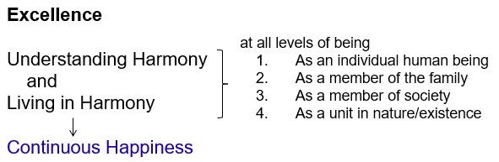
Assignment
Write a letter to one person for whom you have a feeling of gratitude
(It could be your grandparent, parent, sibling (brother-sister), teacher…)
Recall all they have done for your development… for your excellence
(if you recall some things that they could not do, write them also down separately)
Note: You need not submit this assignment to the facilitator

Slide 21
Opposition, Affection and Love
Verify on the basis of your natural acceptance if you want to be related to:
    None
    One
    Many
    Everyone
Affection (Lusg) – The feeling of being related to the other
(acceptance of the other as one’s relative)
nwljs dks laca/kh ds :i esa Lohdkjus dk HkkoA
Love ¼izse½ – The feeling of being related to all (Complete Value)
¾ gj ,d dks laca/kh ds :i esa Lohdkjus dk HkkoA
X
→ The feeling of being related to none
in opposition to all
√
The feeling of being related to one
The feeling of being related to many
Affection
√
√
→ The feeling of being related to all
Love

Slide 22
Assumptions Related to Love Right Understanding – Feeling of Love
Excitement is confused for feeling
A) Sensation, getting/taking from the other
Continuity not possible
B) Infatuation, Assuming Other to be Source of your Happiness
Love at First Sight?
By this age, I must have GF/BF?
The other has 4 GF/BF; I have only one?
Continuity not possible
C) Right understanding
Love (प्रेम) = feeling of being related to all,
responsible towards all
Continuity is possible
Once trust, respect, affection, care, guidance… are ensured within, then
the feeling of being related to all follows naturally
Which option is naturally acceptable to you?
A?
B?
C?

Slide 23
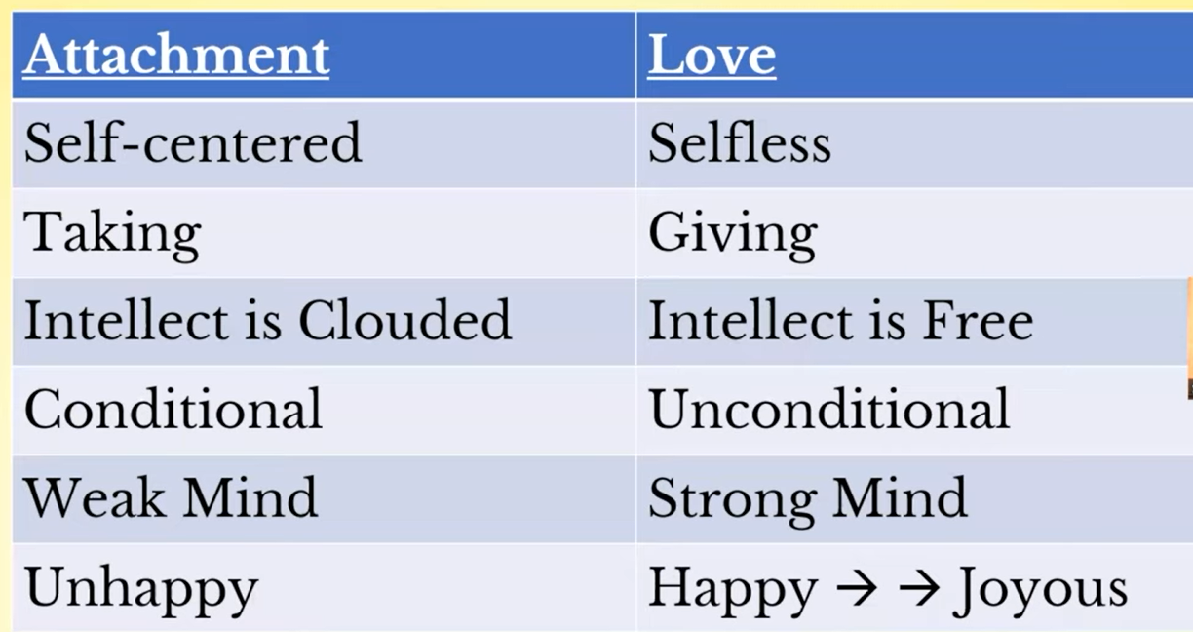

Slide 24
Sum Up
Affection is the feeling of being related to the other
  With affection, one has the responsibility and commitment for mutual fulfilment in the relationship
Excellence is the understanding and living in harmony at all levels of being
  Making effort for Excellence and Competing with the other is not the same thing.
  In excellence, one helps to bring the other to her/his level
  In competition, one avoids the other to come to her/his level
Reverence is the feeling of acceptance for excellence
  (acceptance of the completeness of right understanding in the other)
Gratitude is the feeling for those who have made effort for my excellence
Love is the feeling of being related to all (Complete Value)
  (there are several assumptions related to love which need to be rightly evaluated)
With the right feeling in me, I feel happy. I am able to rightly relate to the other and work for mutual happiness, for justice in relationship

Slide 25
Home Assignment

Slide 26
Home Assignments
11.1. Suggest ways in which we can develop affection among
      Different batches in your institute
      Students of the same batch
11.2. Make a list of people that you take inspiration from.
      Evaluate if they are living in harmony or making effort to do so
      Evaluate the feeling you have for them: is it over, under or otherwise evaluation?
      Evaluate if they are helping others to live in harmony
      Note a few things that you would you like to learn from them
      List a few steps that you need to take to work for excellence
11.3. Make a list of people in your family, in the college and in the larger society who are directly and indirectly participating in fulfilling your needs. What is your feeling for them, how is your interaction with them, what is your contribution (in terms of understanding, feeling and physical facility) to them?
11.4. Distinguish between Love and Infatuation
What do you mostly think about? Love or Infatuation (or something else)?

Slide 27
Questions?

